Slide 1
TASK 2: REPORTING A CRITICAL VULNERABILITY IN A GIVEN WEBSITE

Slide 2
STEPS TO REPRODUCE:
STEP 1: OPEN KALI LINUX IN VMWARE
STEP 2: OPEN FIREFOX AND DOWNLOAD NESSUS VULNERABILITY SCANNER
STEP 3: GO TO TERMINAL AND INSTALL THE PACKAGE
STEP 4: START THE NESSUS SERVICE FROM TERMINAL
STEP 5: THEN GO TO "NEW SCAN" AND CLICK ON WEB APPLICATION TEST
STEP 6: IN TARGET SECTION ENTER THE WEBSITE URL http://zero.webappsecurity.com/

Slide 3
STEP 7: CLICK SAVE AND THEN START THE SCAN
STEP 8: AFTER THE SCAN IS COMPLETE EXPORT THE REPORT AS PDF

Slide 4
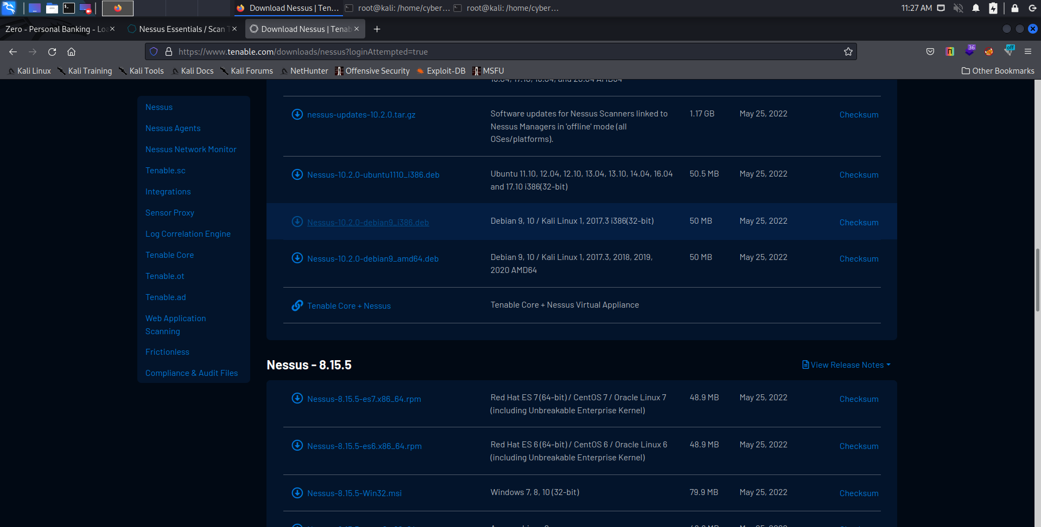

Slide 5
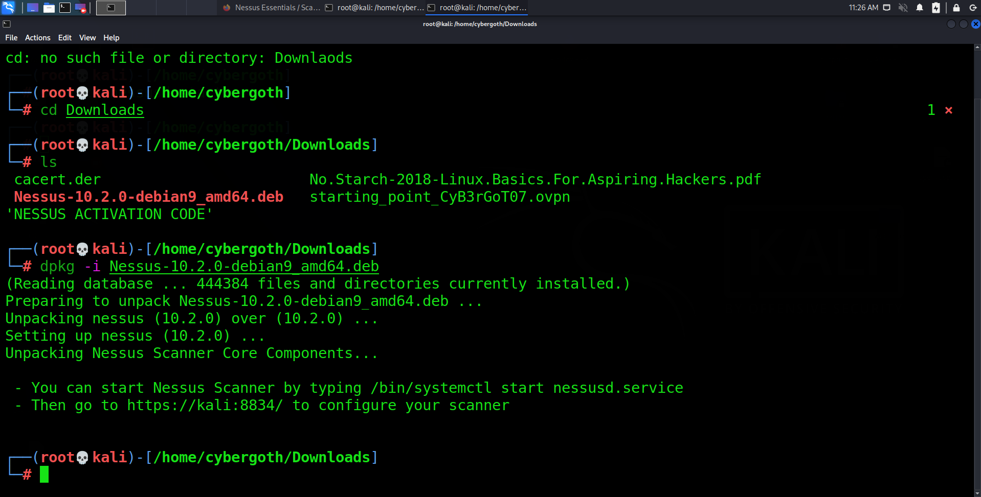

Slide 6
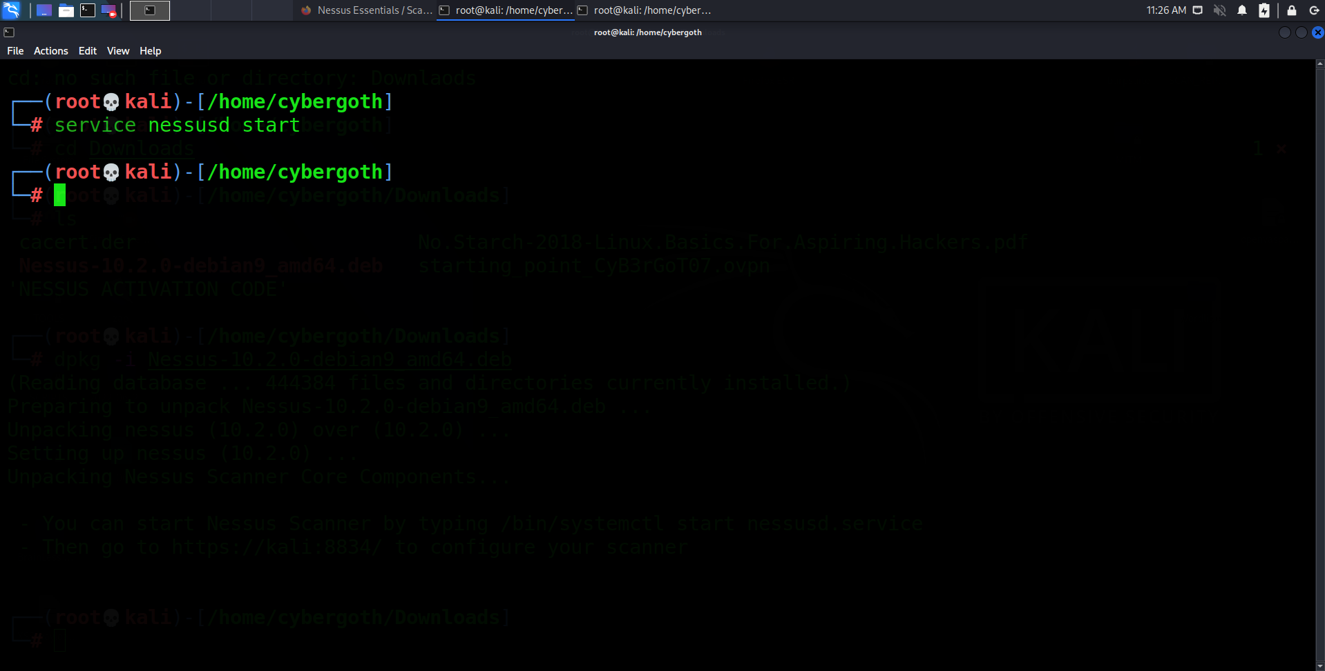

Slide 7
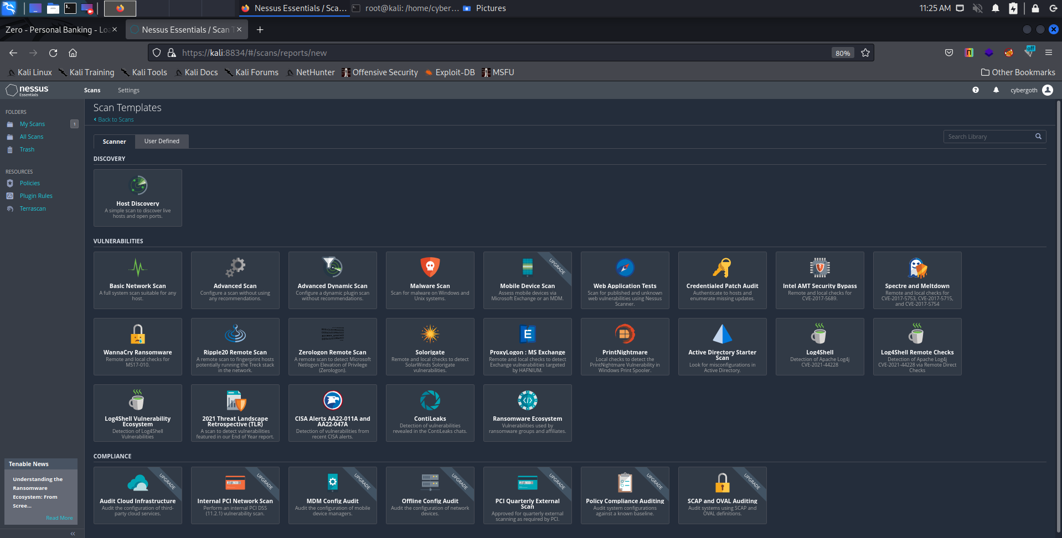

Slide 8
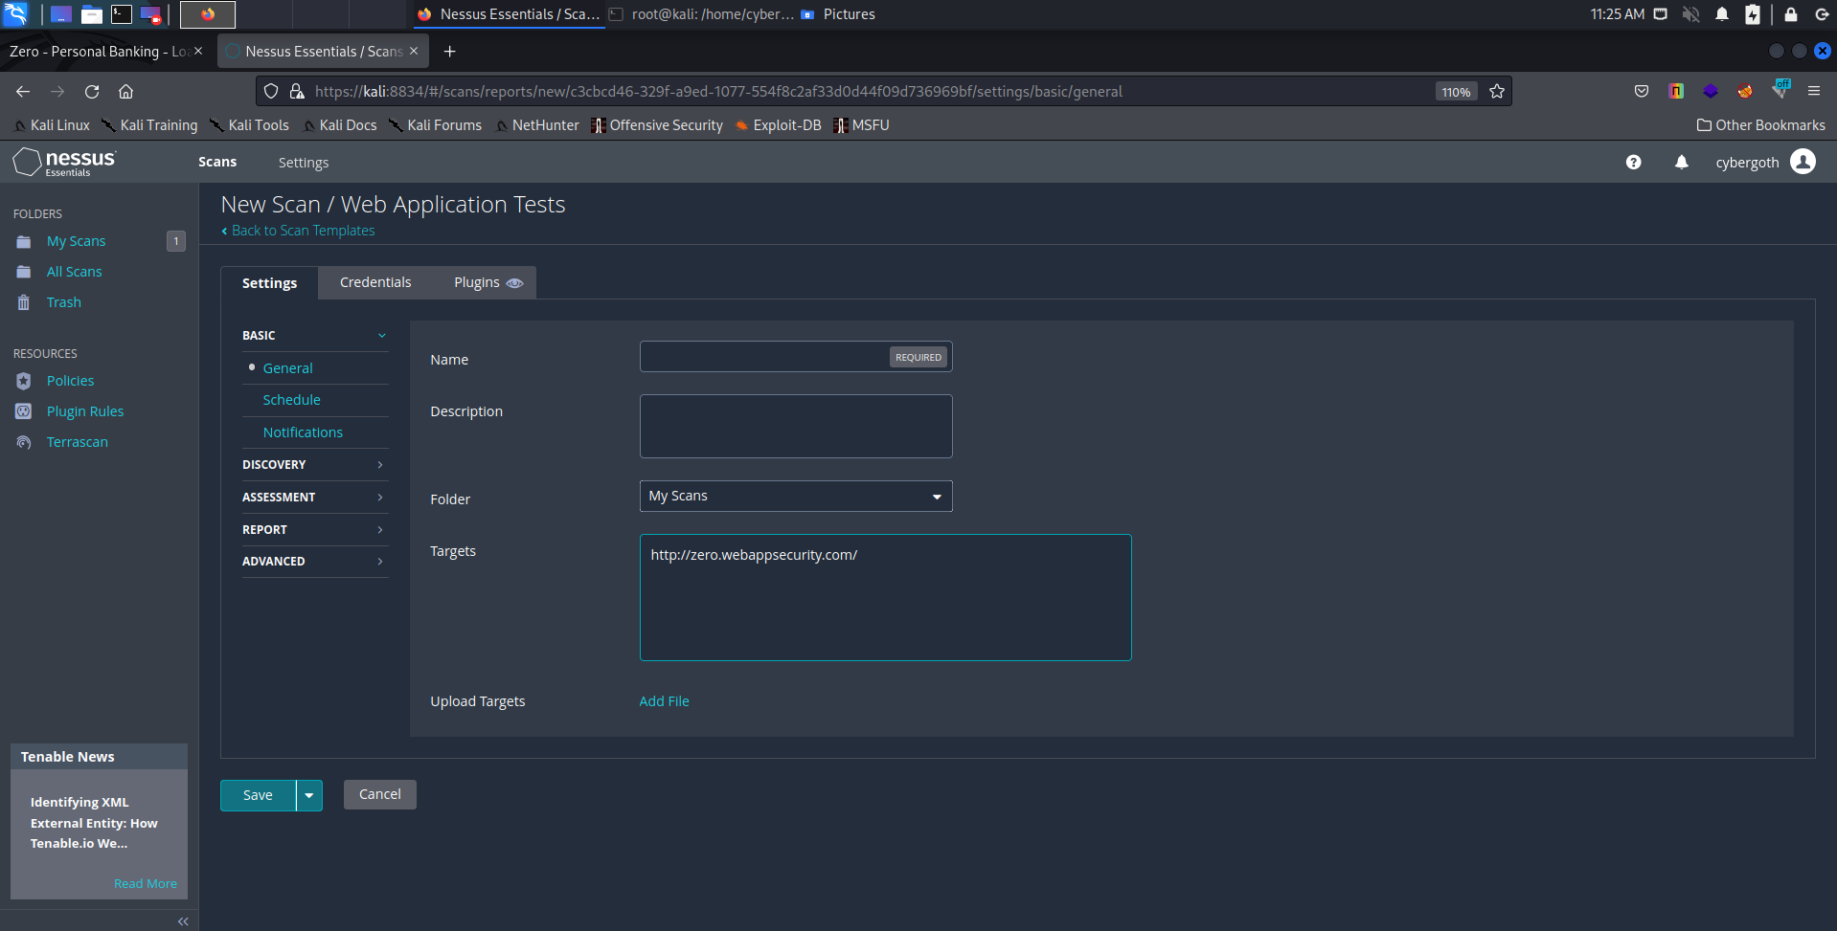

Slide 9
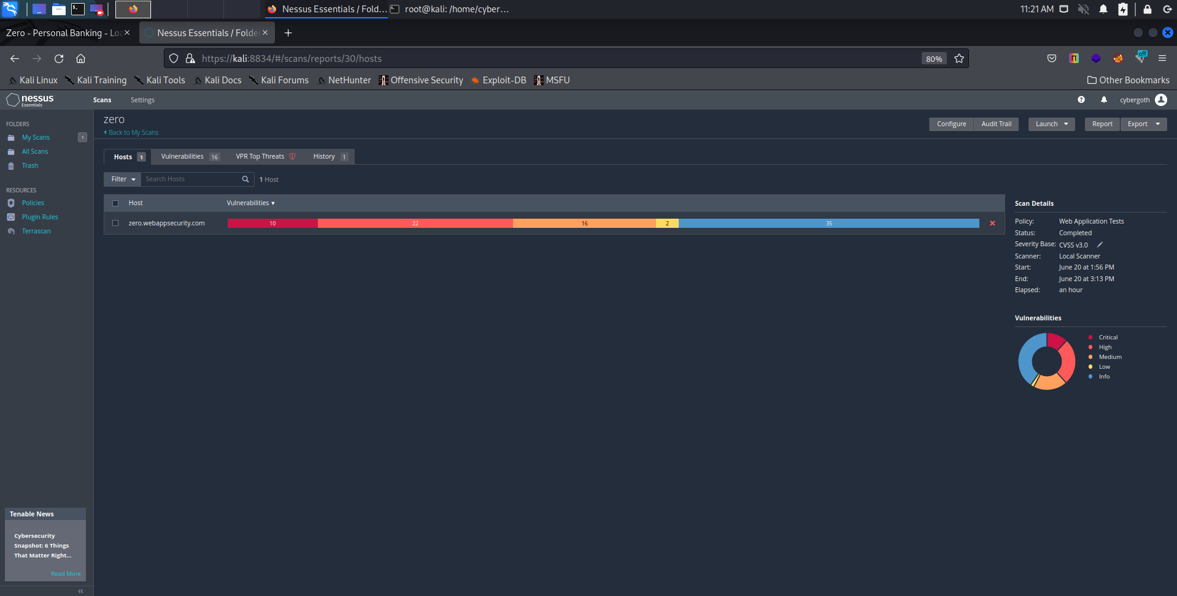

Slide 10
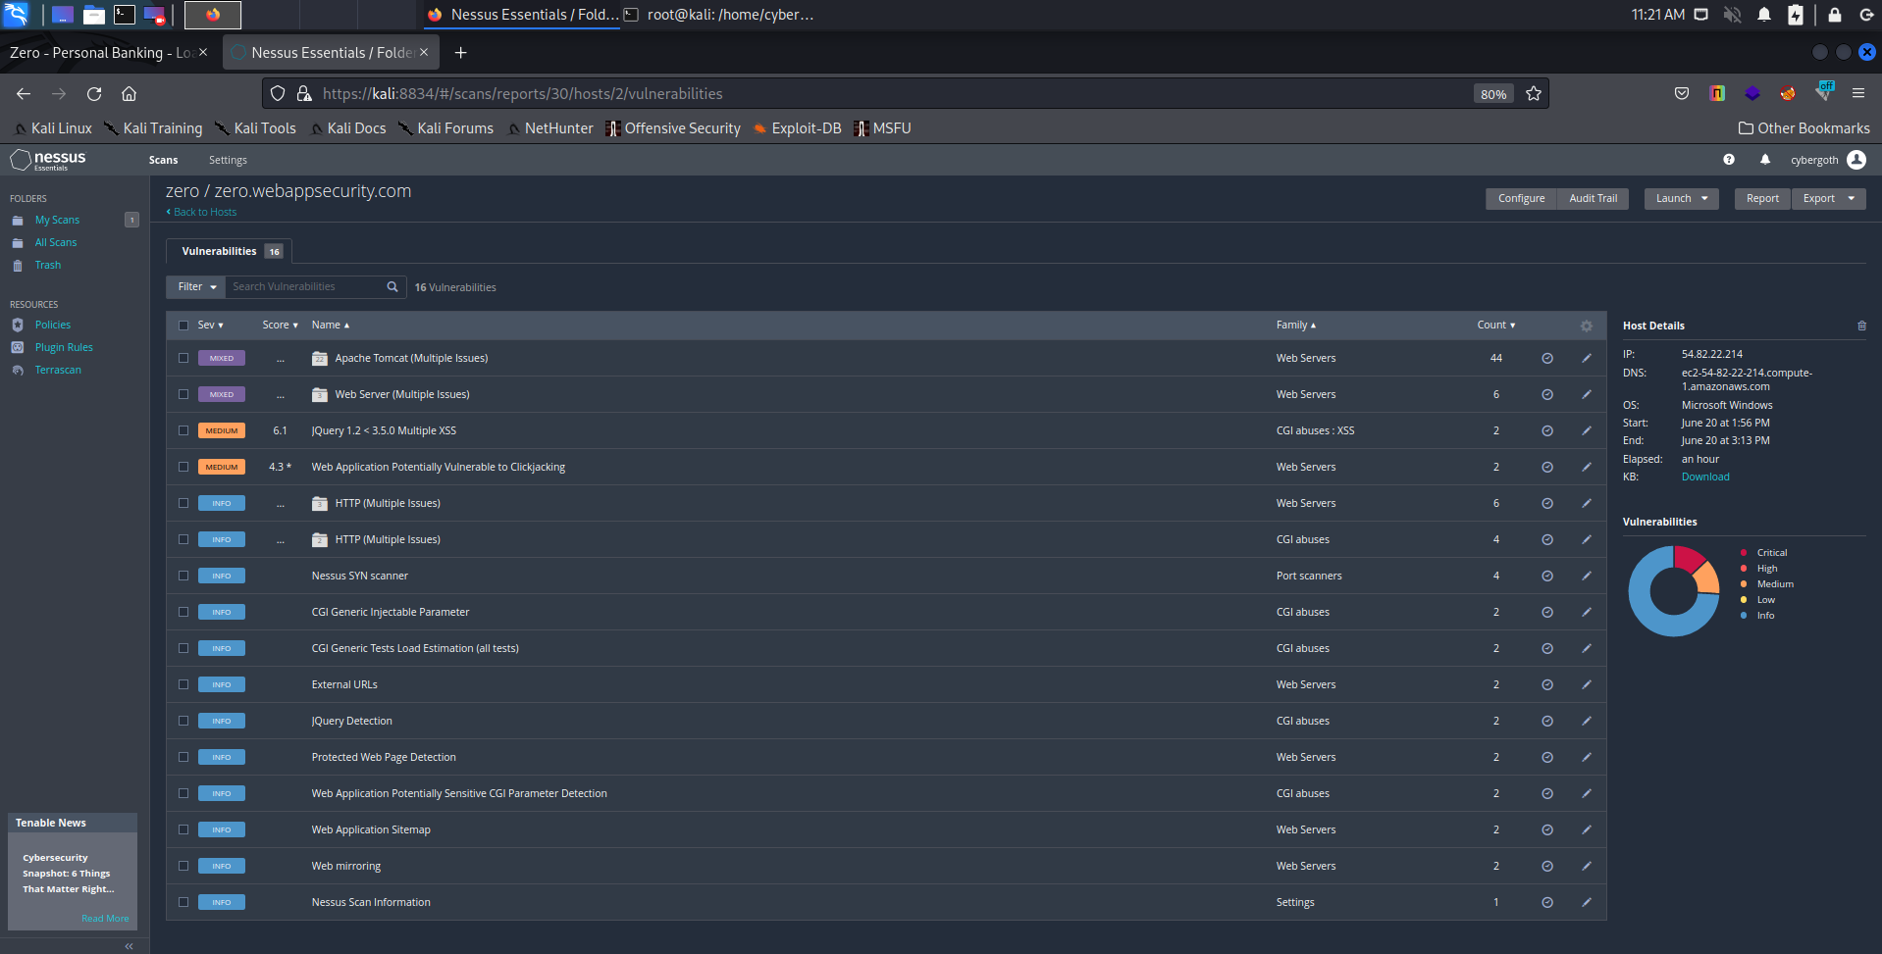

Slide 11
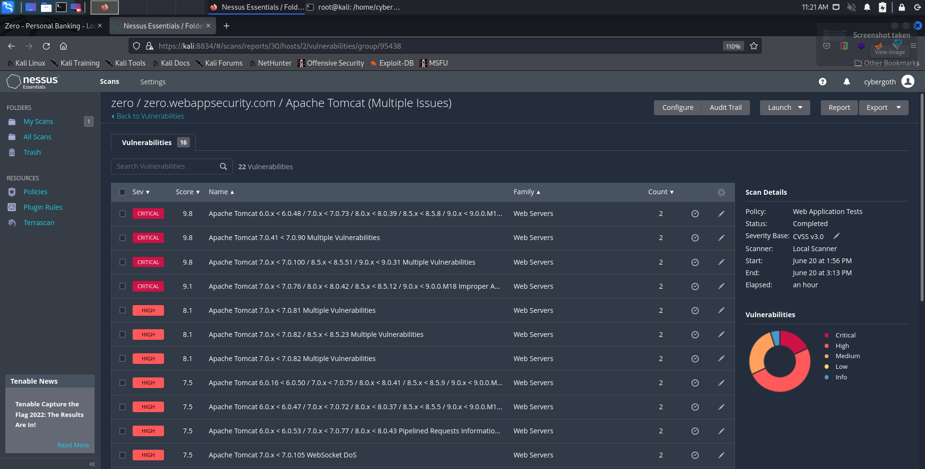

Slide 12
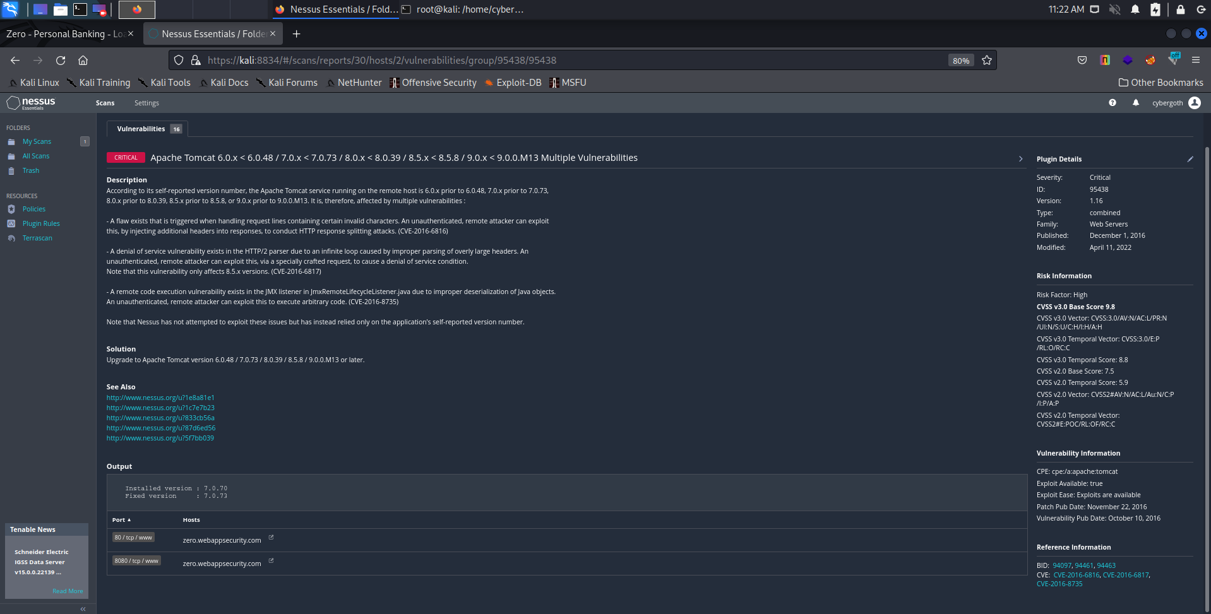

Slide 13
VULNERABILITY
Outdated version of APACHE TOMCAT that causes incorrect parsing of the HTTP transfer-encoding request header in some circumstances, leading to the possibility of HTTP Request Smuggling (HRS) when used with a reverse proxy.

Slide 14
THREAT:
Since it is outdated it allows information disclosure via file retrieval on a vulnerable server , without authentication or a user being tricked into a compromised interaction and in some cases it could allow remote code execution.
Due to the nature of the vulnerability, [the exploit] can be leveraged without any user interactions and with high reliability, with low chance of causing the vulnerable server to crash.
If a vulnerable Tomcat server also allows file uploads (not the default setting, by the way), an attacker could upload their own code via the AJP connector.

Slide 15
Security Measures
Enabling the security manager causes web applications to be run in a sandbox, significantly limiting a web application's ability to perform malicious actions such as calling System.exit(), establishing network connections or accessing the file system outside of the web application's root and temporary directories. However, it should be noted that there are some malicious actions, such as triggering high CPU consumption via an infinite loop, that the security manager cannot prevent.
Enabling the security manager is usually done to limit the potential impact, should an attacker find a way to compromise a trusted web application . A security manager may also be used to reduce the risks of running untrusted web applications (e.g. in hosting environments) but it should be noted that the security manager only reduces the risks of running untrusted web applications, it does not eliminate them. If running multiple untrusted web applications, it is recommended that each web application is deployed to a separate Tomcat instance (and ideally separate hosts) to reduce the ability of a malicious web application impacting the availability of other applications.

Slide 16
WHERE THE THREAT WAS FOUND:
URL: http://zero.webappsecurity.com/
SERVER: Apache-Coyote/1.1

Slide 17
HOW IT WAS DETECTED:
IT WAS DETECTED BY A WELL KNOWN AND POPULAR AUTOMATIC VULNERABILITY SCANNER KNOWN AS NESSUS

